Slide 1
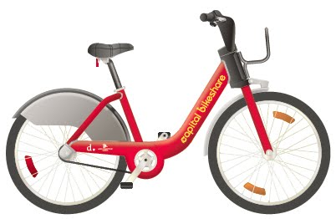

Capital Bike Share System
in Washington DC
Team 3
Abhishikta Vanga
Mownika Chalichama
Seshi Saraswathi
Samyuktha Anand

Slide 2


How does bike share system work ??

Slide 3
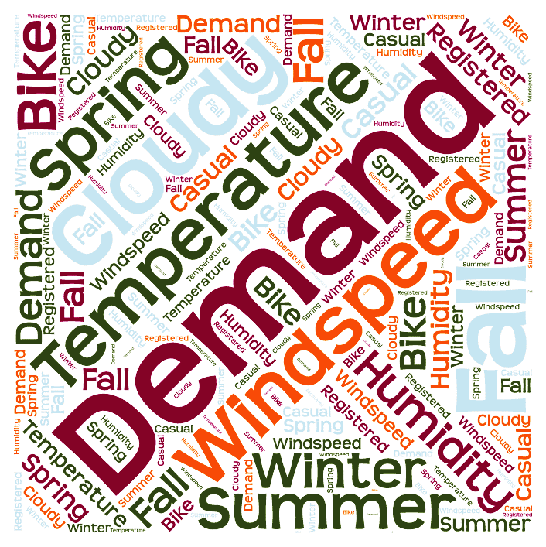
Business Case
Most of the businesses involved in this system of bike rental are faced with the challenge of balancing between supply and inconsistent demand.
It depends on many other external factors like temperature, wind speed, season, time

Slide 4

Problem Statement
Forecast the bike rental demand in the Capital Bike Share Program in Washington, D.C. combining the historical usage patterns with weather data

Slide 5
Overview of Data Set
Field Name | Data Type | Description
datetime | date/year | date in daily/weekly format
season | integer | 1 = spring, 2 = summer, 3 = fall, 4 = winter
holiday | boolean | whether the day is considered a holiday
working day | boolean | whether the day is neither a weekend nor holiday
weathersit | integer | 1: Clear, Few clouds, Partly cloudy, Partly cloudy 2: Mist + Cloudy, Mist + Broken clouds, Mist + Few clouds 3: Light Snow, Light Rain + Thunderstorm + Scattered clouds
temp | decimal | temperature in Celsius
atemp | decimal | “feels like” temperature in Celsius
humidity | integer | relative humidity
windspeed | decimal | windspeed
Casual/Registered | integer | number of nonregistered/registered users
Renters Count | integer | number of total rentals

Slide 6
Data Exploration
Count of total Bike share users over Time

Slide 7
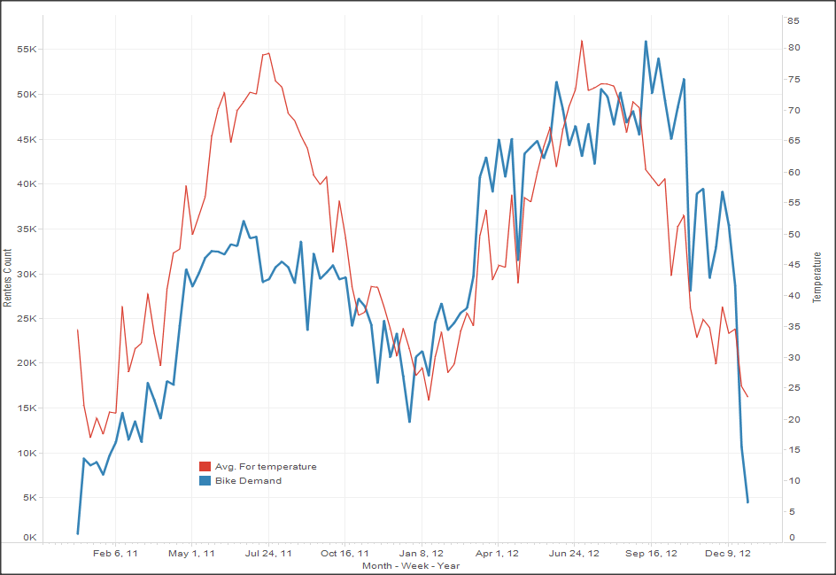
Data Exploration
Impact of temperature on the Bike rental Demand

Slide 8
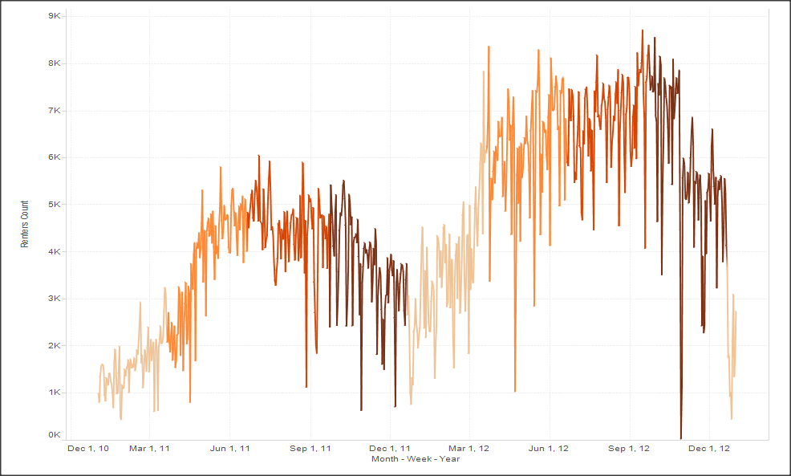

Data Exploration
Impact of Season on the Bike rental Demand
Winter
Spring
Summer
Fall

Slide 9
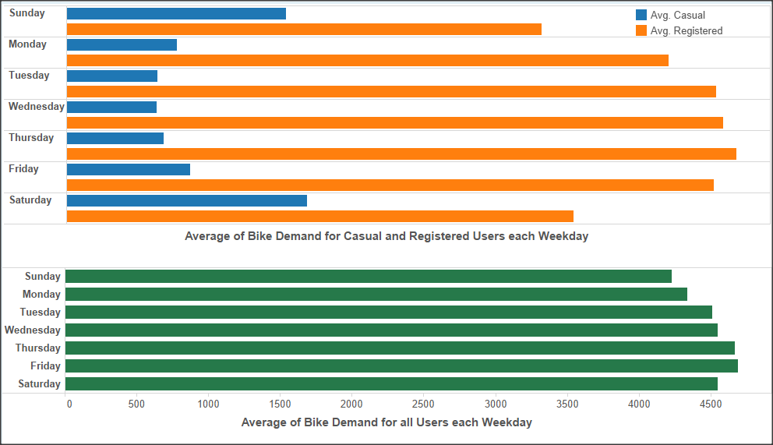
Data Exploration
Number of Bike share users across Week

Slide 10
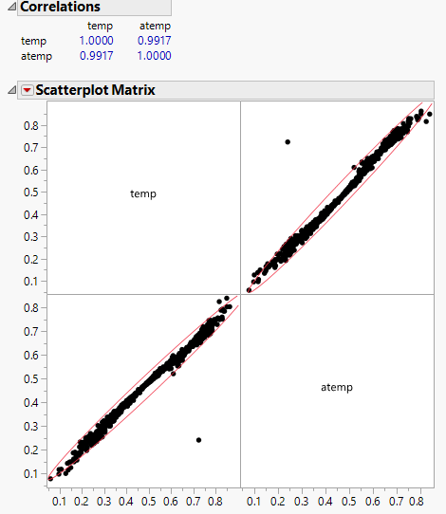
Data Exploration
High Correlation between temperature and “Feels Like” temperature variables

Slide 11
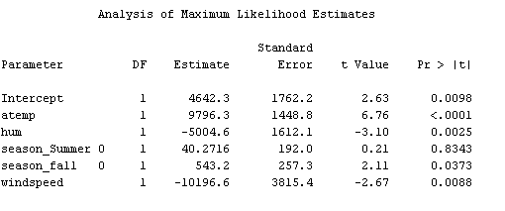
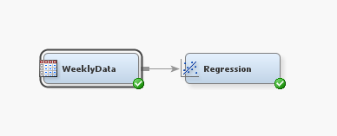
Predictor Variables
Response Variable :
Bike Rental Demand Count

Slide 12
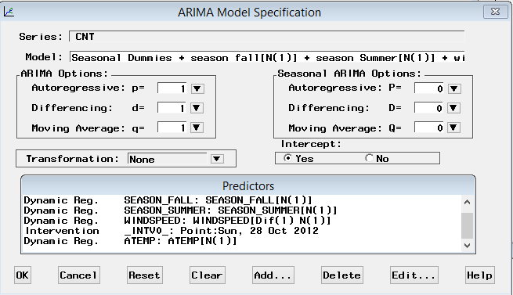
Forecasting Model

Slide 13
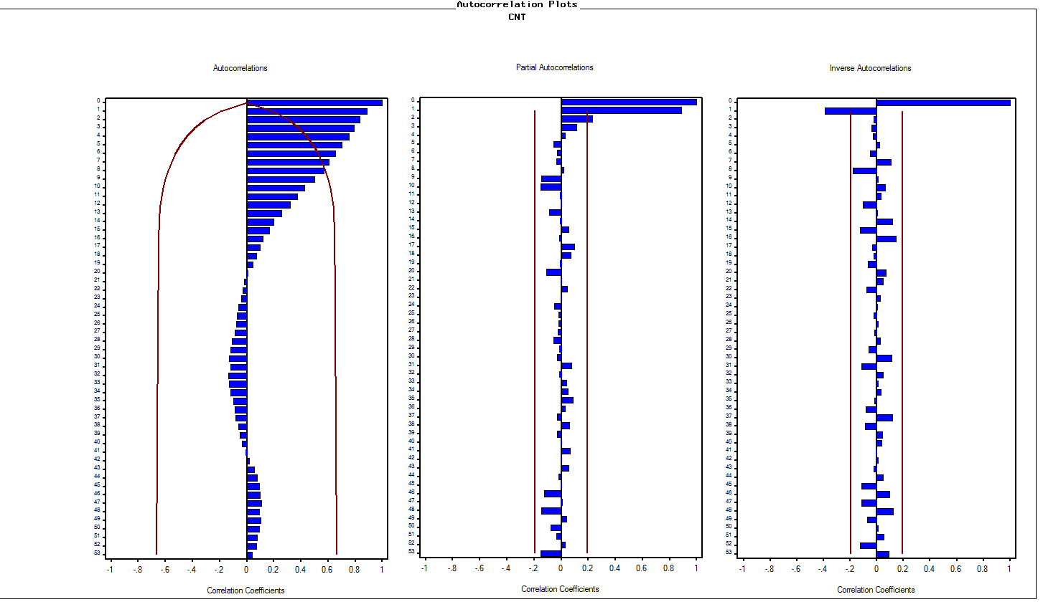
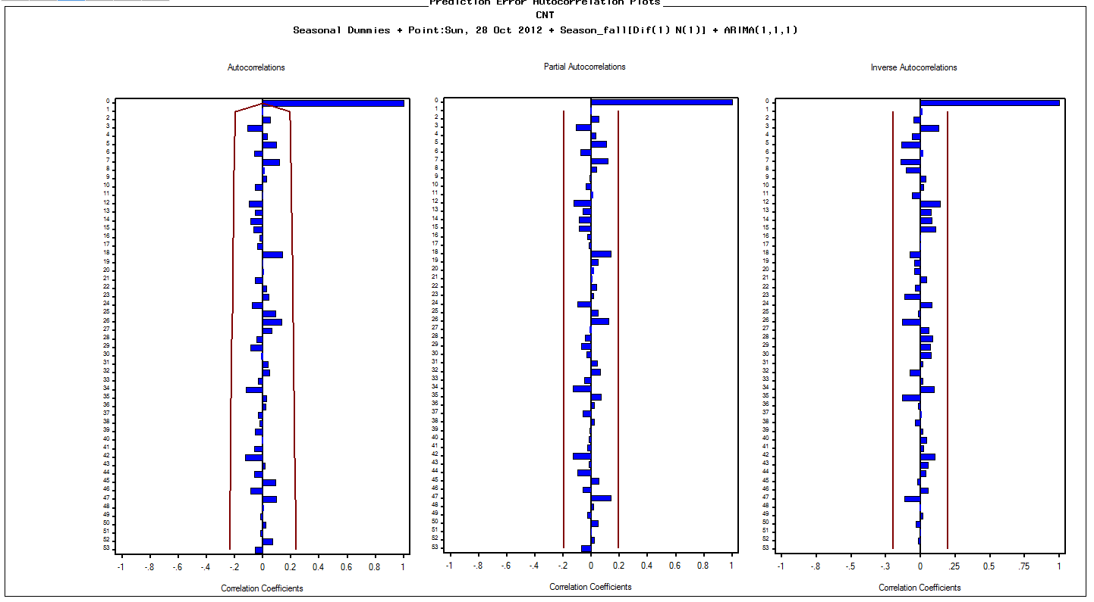
Model Development Process
Auto correlation plots – Original Data
Auto correlation plots of residuals

Slide 14
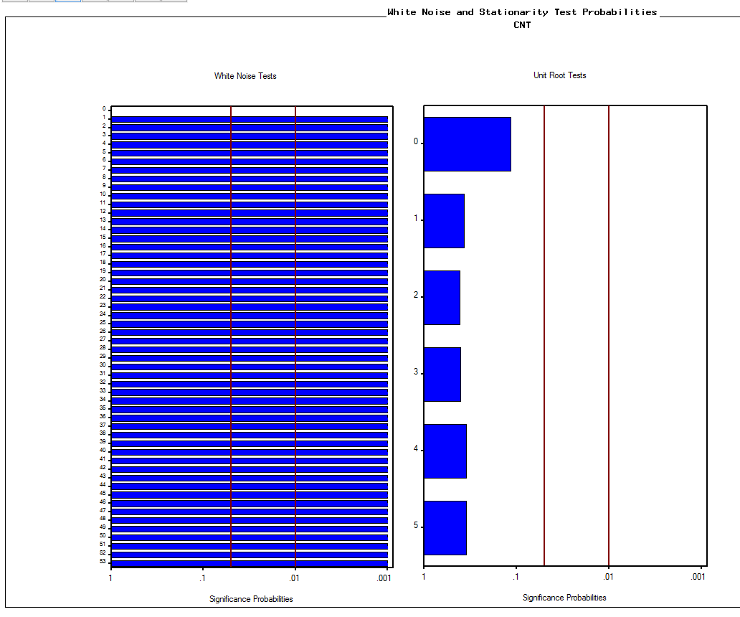
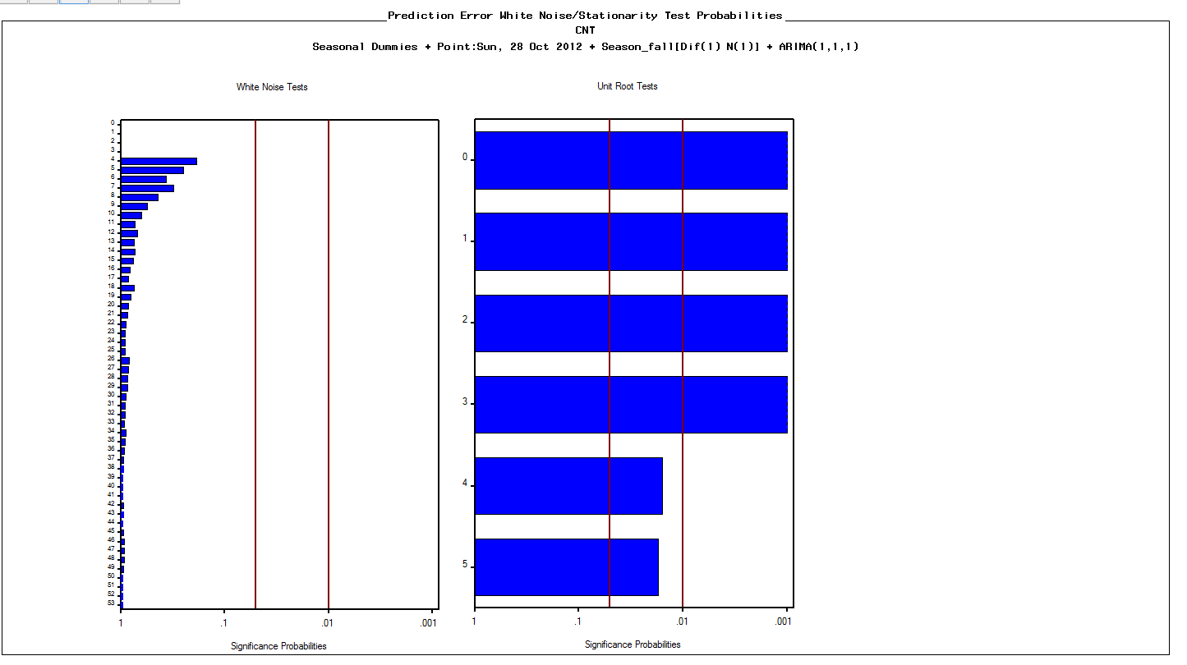
Modeling
White noise tests– Original Data
White noise tests– After modelling

Slide 15
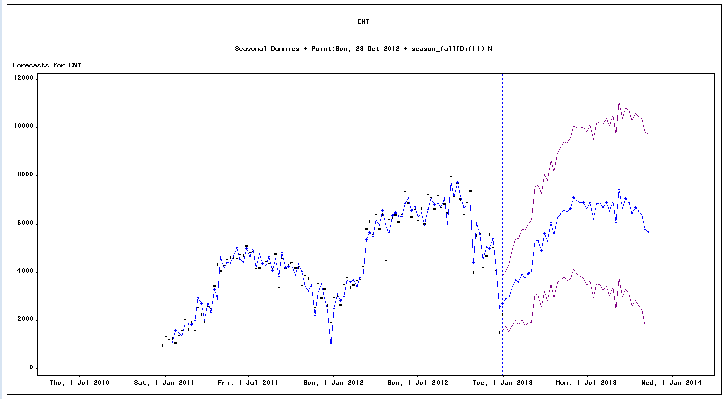
Modeling
Forecasted Output for 30 Weeks from 01/JAN/2013
Best Model | ARIMA(1,1,1) with Regressors
MAPE | 8.36
RMSE | 387.18
R Square | 0.94

Slide 16
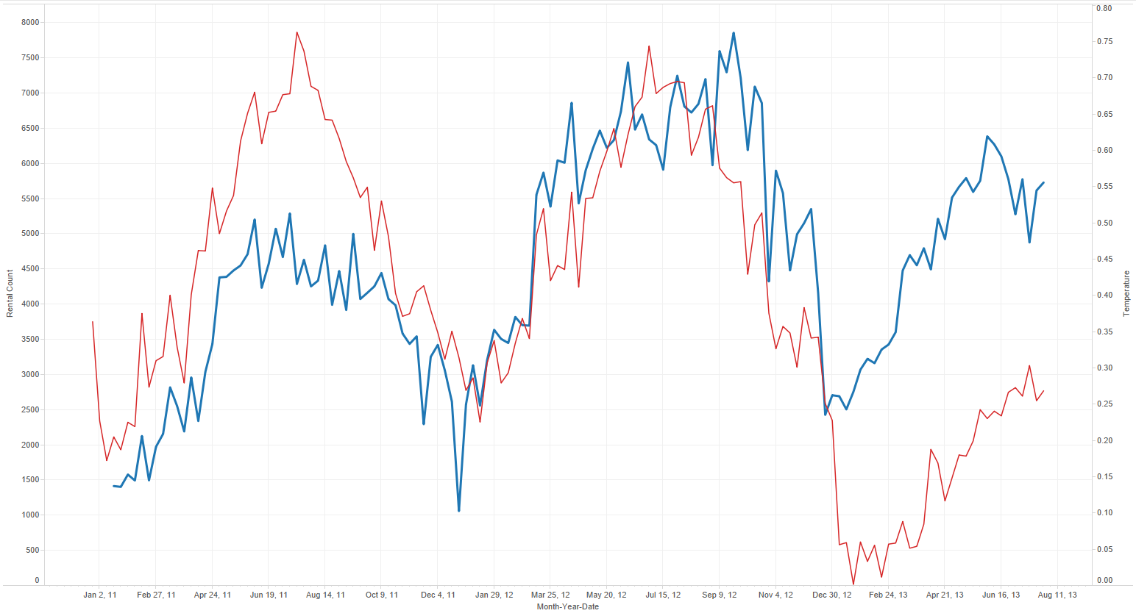
Scenario Analysis on Predicted Count Vs Temperature
Scenario:
For a Temperature change of every 5deg Celsius
Impact:
The Bike rental demand goes up by 200
Note: Till threshold of 60 Celsius

Slide 17
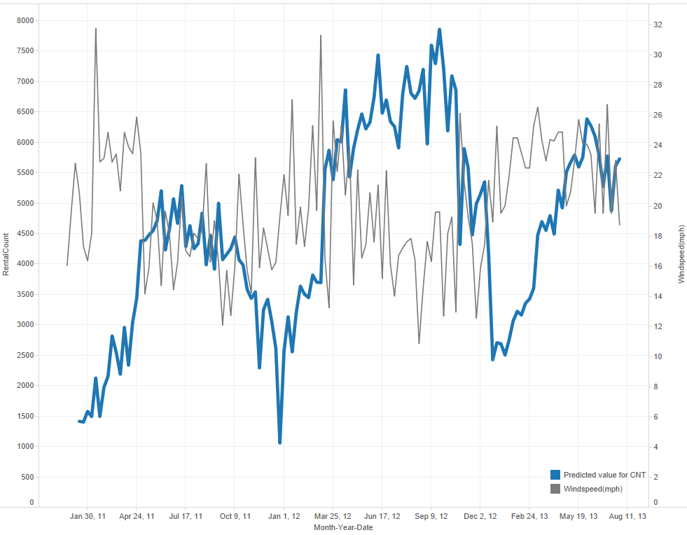
Scenario Analysis on Predicted Count Vs WindSpeed
Scenario:
Wind speed increased from 19mph to 26mph
Impact:
The Bike rental demand goes down by 300

Slide 18
Conclusions and Recommendations
Business will be able to bridge the gap between supply and demand of the bikes
The Scenario analysis can be of help to the management to make instantaneous decisions either to raise or slash the tariff rates based on the weather changes.
Knowing the information about the rate at which users are registering over a period of time would be helpful in forecasting the demand more accurately in long run.

Slide 19

Thank You

